Slide 1


Project Glimmer
Team 15
Mike DesRoches
Christian Garcia
Jake Lahr
Alexandra Pasinski
Advisor
TBD

Slide 2
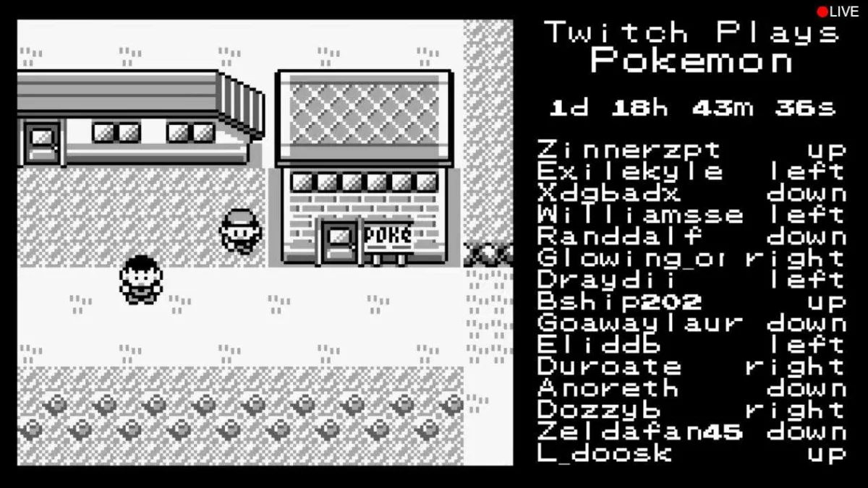
What is it?
Project Glimmer is a software API that is aimed for game developers to use as an easy way to integrate web video streaming chat interaction within their game.
This is to help the developers create a new way of interaction for players and viewers of their game.
We use the term OTMP (One-to-many player game) to describe this form of interaction.

Slide 3
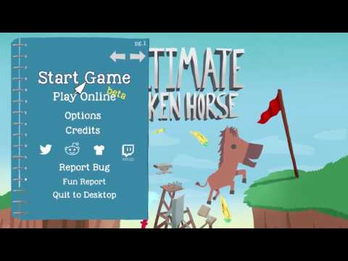
What is Stream Chat Interaction?
Stream chat interaction within a video game works by taking input commands from chat (EX: !potion) and changing the state of the game for the player streaming based on the commands.
This can create a unique gameplay experience for the player and increased stream interaction for the viewers.
Play till 0:45

Slide 4

Who is it for?
The API would be used by game developers to integrate with their video games. Game developers across all platforms are our target audience.
Streaming services, such as Twitch.tv, have large user bases that game developers will now have the ability to reach using our API.

Slide 5
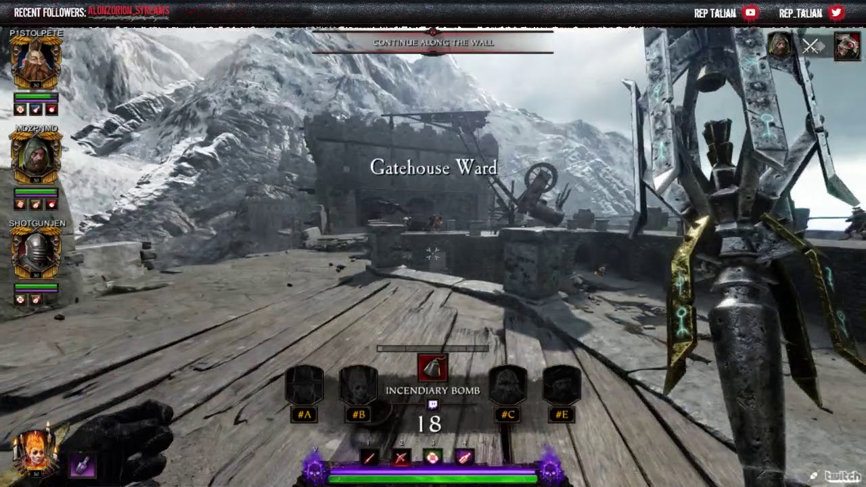
Competition
There are no obvious alternatives already available on the market as most solutions relating to the problem of live stream integration are developed in-house and not open sourced to the larger game development industry.
One example of an OTMP game is Warhammer: Vermintide 2, where the developers put in options for viewers to vote on what change happens next in the game.

Slide 6
Why is it worthwhile?
27 million people tuned in to live streaming services to watch the League of Legends world championship.
There is a large potential market of users that game developers could reach by integrating live streaming chat interaction into their games.
Our API will likely be the only open source solution available on the market for some time.
Notes:
Games are constantly evolving in a way where user interaction isn’t just playing the game. User’s also love to watch the game. 27 million people tuned in to watch the League of Legends world championship.
Viewer interaction with a game could increase the value of eSports entertainment industry
https://ftw.usatoday.com/2014/12/league-of-legends-worlds-viewership-esports-world-series-nba-finals

Slide 7

Questions?

